Slide 1

Learn Azure Cloud Shell in 12 minutes
Mike Nelson
VMware Explore VMTN 2022

Slide 2
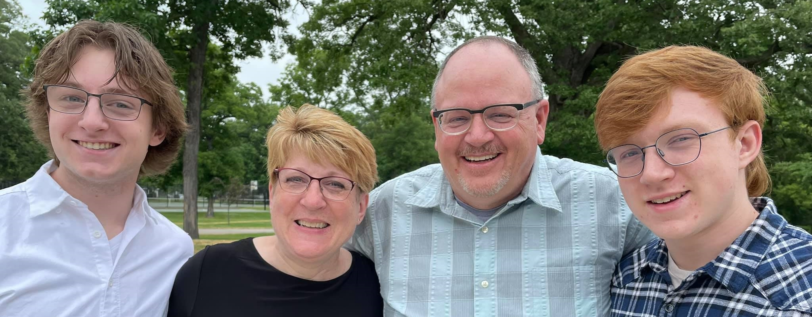




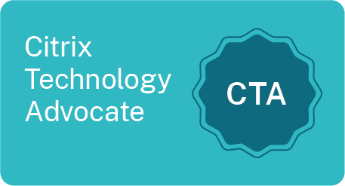
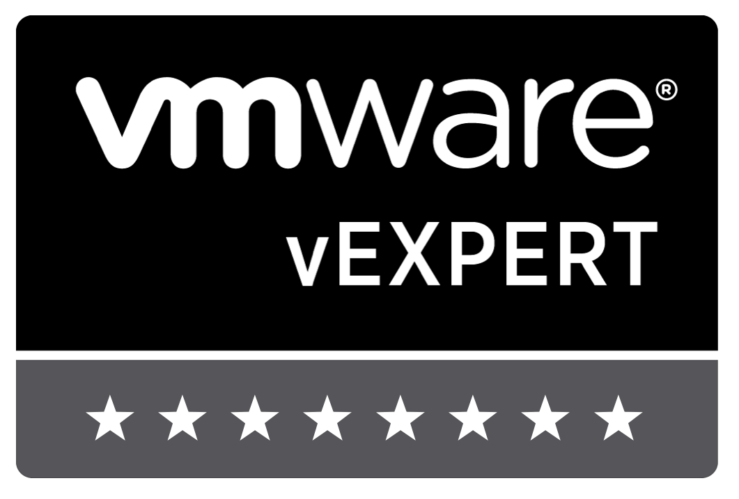
mikenelsonio
Mike
nelmedia
mikenelson-io
35+ years in tech
Principal Technologist @ Cohesity
Experience from Helpdesk to Architect
Scripter, not a coder
Passion for community, teaching, learning
Beer, BBQ, & Gadgets

Slide 3
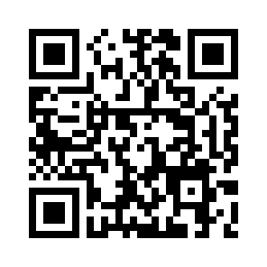
/MyPresentations/2022-August_vmware explore vmtn

Slide 4
Cloud shell is a Microsoft managed CLI shell for the administration of resources in Microsoft Azure.
CLOUD SHELL

Slide 5
Thank you!
@mikenelsonio
GitHub - mikenelson-io
LinkedIn - nelmedia

